Slide 1
Famous People Who Got Their Start as Teachers

Slide 2
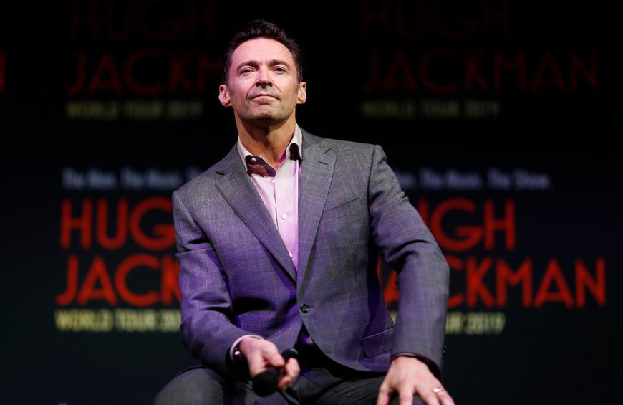
Famous People Who Got Their Start as Teachers
Hugh Jackman
After graduating high
school in Australia,
actor Hugh Jackman spent
a gap year
working as a P.E. teacher
and English
and drama tutor at the
Uppingham School in London,
England. While walking the
red carpet at a film
festival in 2013,
Jackman recognized one of
his former students
working as an entertainment
reporter and asked him
about the progress of
his physical education.

Slide 3
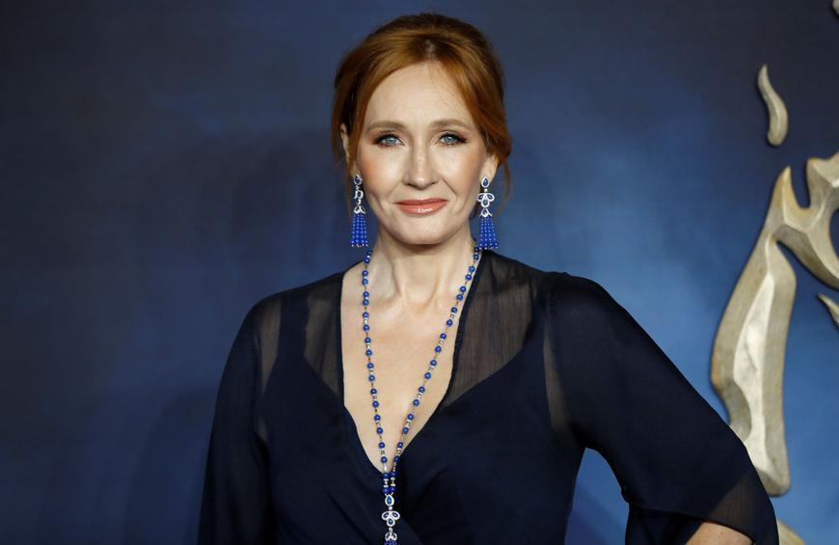
Famous People Who Got Their Start as Teachers
J. K. Rowling
In 1991, J.K. Rowling moved to Porto, Portugal, to teach English as a foreign language for two years. She taught at night, and during the day, she began writing the first chapters of the first Harry Potter book. Today, Harry Potter is the best-selling book series in history.

Slide 4
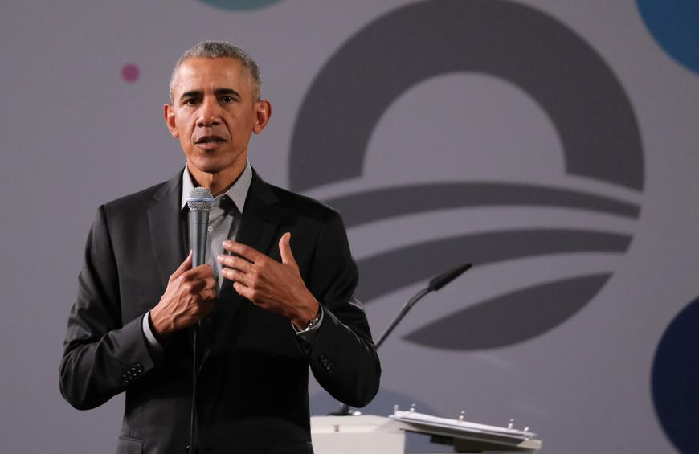
Famous People Who Got Their Start as Teachers
Barack Obama
After graduating from Harvard Law School, former President Barack Obama taught constitutional law and race theory for 12 years at the University of Chicago Law School. During this time, he began his political career by being elected to the Illinois State Senate.

Slide 5
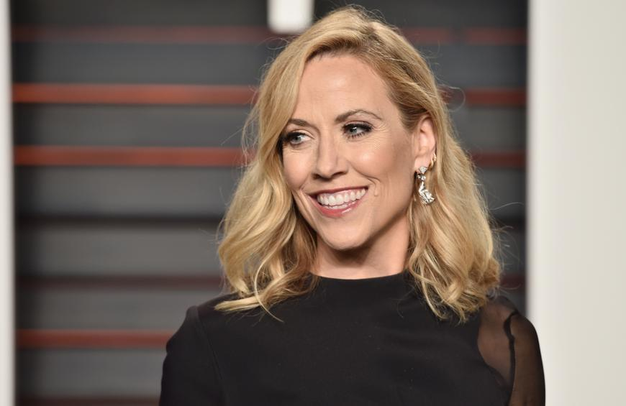
Famous People Who Got Their Start as Teachers
Sheryl Crow
Grammy-winning musician Sheryl Crow's first job after college was working as a music teacher in an elementary school in St. Louis. She moved to Los Angeles and worked as a backup singer before making it big.

Slide 6
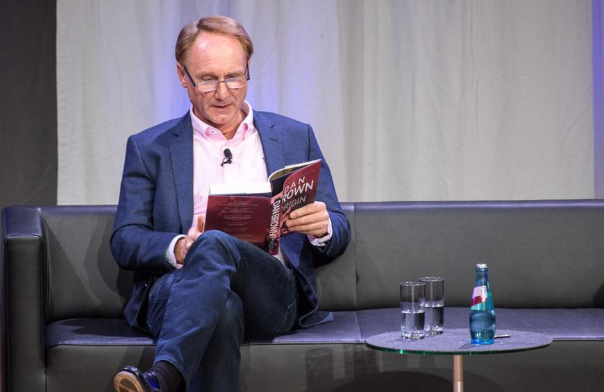
Famous People Who Got Their Start as Teachers
Dan Brown
Best-selling "Da Vinci Code" author Dan Brown graduated from Amherst College and then taught English and Spanish at Beverly Hills Preparatory School in Los Angeles and his alma mater Phillips Exeter Academy in New Hampshire. He quit teaching in 1996 to become a full-time writer.

Slide 7
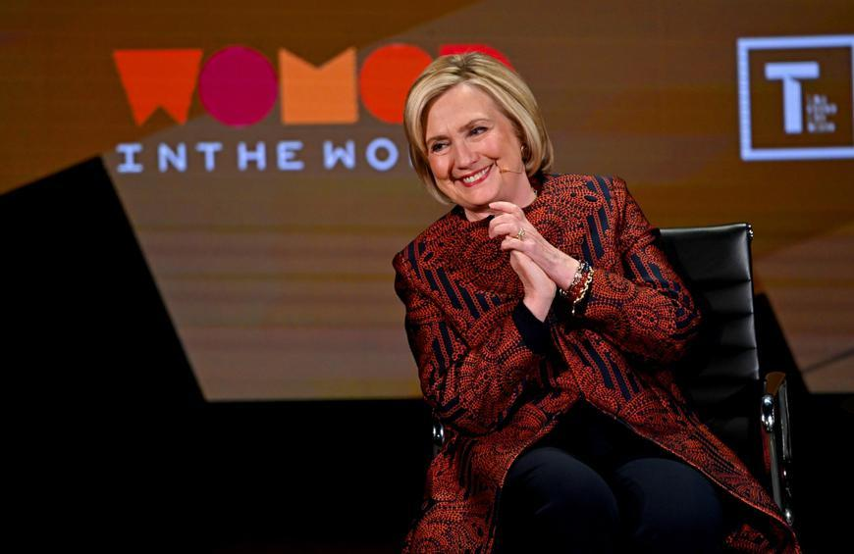
Famous People Who Got Their Start as Teachers
Hillary Clinton
After graduating from Yale Law School and passing the bar exam, Hillary Rodham followed her then-boyfriend Bill Clinton to Fayetteville, Arkansas, where she taught criminal law at the University of Arkansas, Fayetteville's law school.

Slide 8
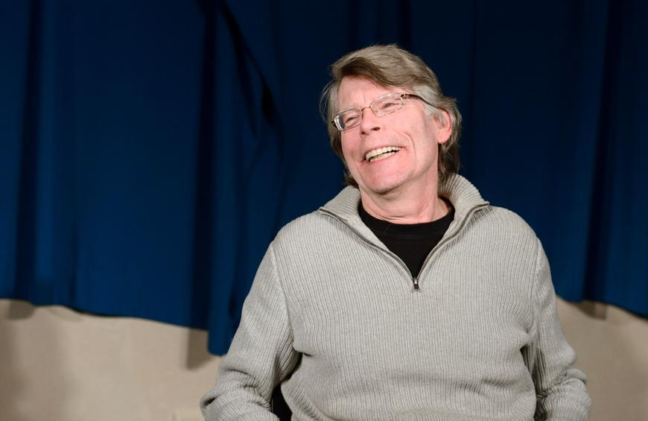
Famous People Who Got Their Start as Teachers
Stephen King
After graduating from the University of Maine, acclaimed horror writer Stephen King got his teaching certificate and worked at Hampden Academy in Hampden, Maine, before publishing his first novel, "Carrie."

Slide 9
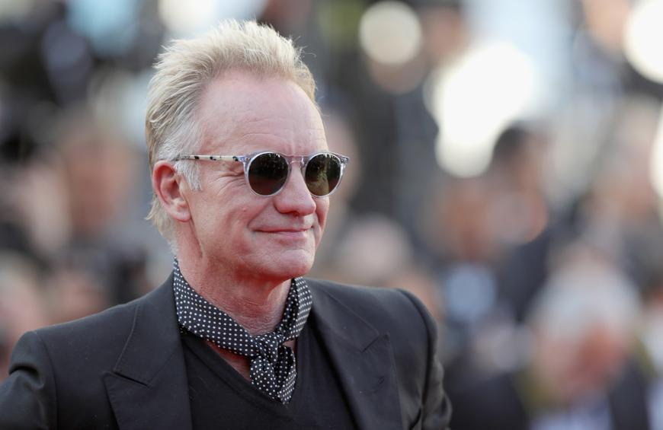
Famous People Who Got Their Start as Teachers
Sting
Before his music career, Sting studied at Northern Counties College of Education and worked as a teacher in Cramlington, England, for two years. He then moved to London and formed his band, the Police.

